Slide 1

life expectancy prediction
Submitted by : Chhavi

Slide 2
Objective
Developing a model that can accurately calculate life expectancy based on historical data and trends.
Identifying the key factors that contribute to life expectancy such as lifestyle choices, environmental factors etc.
Creating a model that can be used by healthcare providers to develop more accurate pricing models and reduce the risk of losses due to unexpected deaths.
Building a tool that can be used by healthcare providers to identify patients who are at risk of developing life threatening diseases.
Informing public policy decisions related to healthcare, retirement and social security.

Slide 3
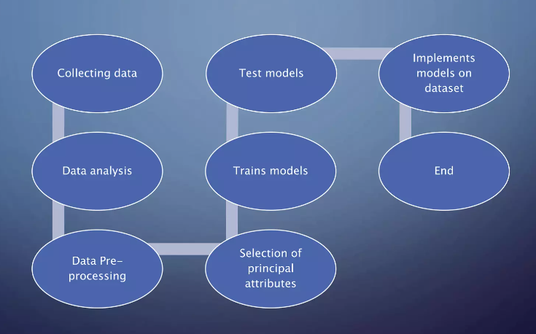
Methodology

Slide 4
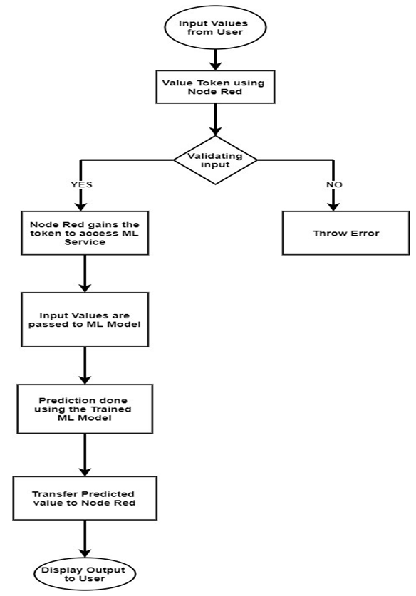
Flowchart

Slide 5
Advantages and Disadvantages
Advantages:-
Easily identifies trends and patterns
Wide Applications
Handling multi-dimensional and multi-variety data
No human intervention is needed (automation)
Continuous Improvement
Disadvantages:-
High error-susceptibility
Needs a lot of time to implement
Interpreting the results accurately
Data set collection is a complex task

Slide 6
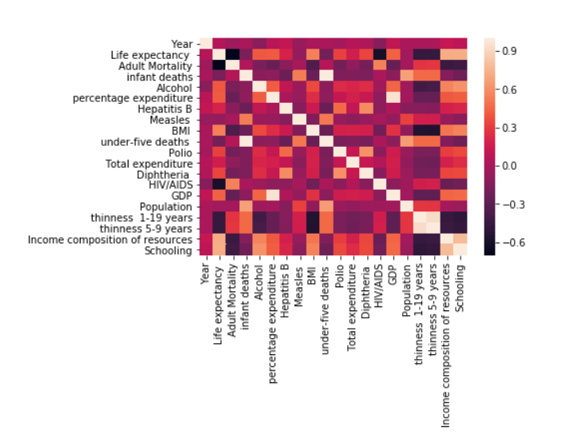
Data Visualisation

Slide 7
Models used in training
Linear and Multilinear Regression Model
Polynomial Regression Model
Decision Tree Regression Model
Random Forest Regression Model
Logistic Regression Model

Slide 8
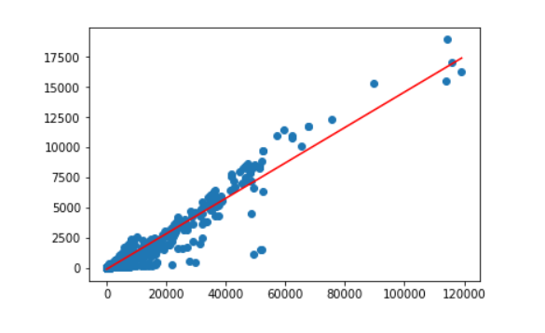
Linear and Multilinear Regression
Linear regression is one of the most common techniques of regression analysis when there are only two variables. Multiple regression is a broader class of regressions that encompasses linear and nonlinear regressions with multiple explanatory variables.

Slide 9
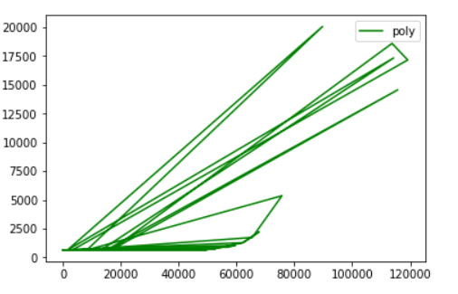
Polynomial Regression
Polynomial Regression describes the fitting of a nonlinear relationship between the value of x and the conditional mean of y. It usually corresponded to the least-squares method.
It is used when there is no linear correlation between the variables. Hence, it explains why it looks more like a non-linear function.

Slide 10
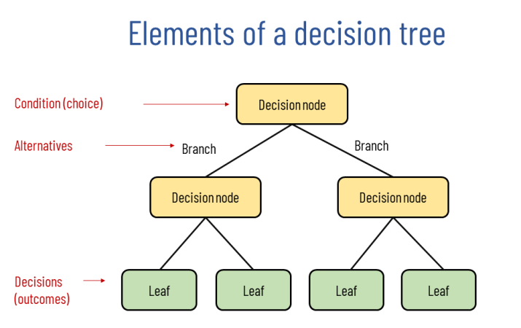
Decision Tree Regression
Observes features of an object and trains a model in the structure of a tree to predict data in the future to produce meaningful continuous output.
Works by splitting the data up in a tree-like pattern into smaller and smaller subsets. Then when predicting the output value of a set of features, it will predict the output based on the subset that the set of features fall into.

Slide 11

Random Forest Regression
Used an ensemble of decision trees to predict continuous numerical values.
Multiple decision trees are constructed and combined to form a “forest”. Each tree in the forest is trained on a different subset of the data, using a random sample of features at each node.

Slide 12
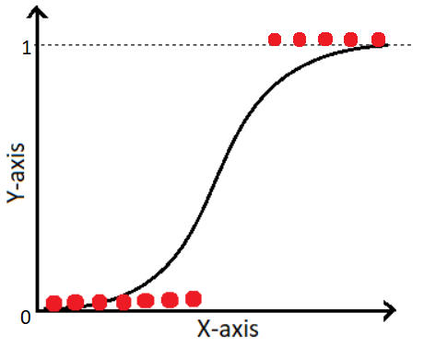
Logistic Regression
This type of statistical model is often used for classification and predictive analytics. Logistic regression estimates the probability of an event occurring, such as voted or didn't vote, based on a given dataset of independent variables.
It is used to obtain odds ratio in the presence of more than one explanatory variable

Slide 13
Predict and Model Tunning
A confusion matrix is used to describe the performance of a classification model (a “classifier”) in binary data for which the true values are known as well. In its simplest and most typical presentation, it is a special contingency table with two dimensions used to evaluate the results of the test or algorithm.
Each row of the matrix represents the ascribed or attributed class while each column represents the actual condition (the truth). The cells of the confusion matrix report the number of true positives and false positives, and false negatives and true negatives.

Slide 14
Future Scopes of Improvement
Incorporating more data: As more data becomes available, the life expectancy prediction model could be improved by incorporating new sources of data. This could include environmental data, genetic data and data from wearable devices.
Increasing accuracy: The ability to explain how an ML model makes predictions is becoming increasingly important. Future life expectancy prediction models could be developed with more transparent algorithms that allow for greater interpretability.

Slide 15


